Slide 1


FINAL YEAR PROJECT
CODEHUB
REVIEW

Slide 2
Group Members:- AYESHA JAVED(30) AYESHA MALIK(12)
CODEHUB
Supervisor:-
Mam Nazia Bibi

Slide 3
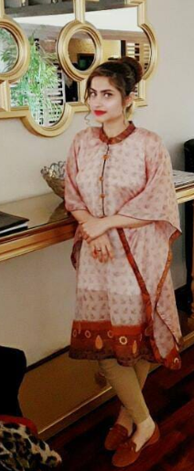

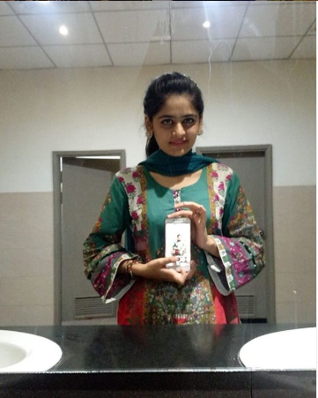

Slide 4

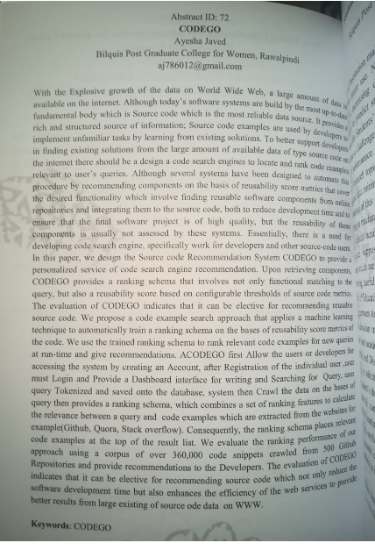


CODEHUB
Presented in 2nd International Multidisciplinary Graduate Confernnce in BPGCW

Slide 5

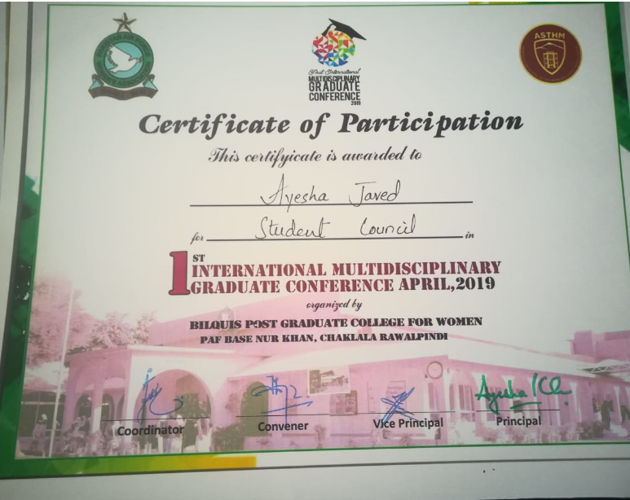

CODEHUB CERTIFICATION:

Slide 6


TITLE
CODEHUB

Slide 7

LOGO

Slide 8
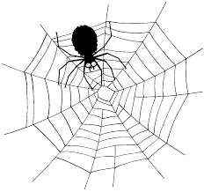



Main Modules
CODEHUB
Crawl Data from Selected Sources---Crawling
Rank the Source file at the Top ---Ranking
Recommend the best Fit source Code file(repo)—Recommendation
Downloading the Source file--Downloading

Slide 9
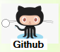


Sources
CODEHUB
Source Code

Slide 10
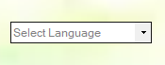
No of languages
HTML
C
C++
C#
JAVA
ASP.NET
PYTHON
RUBY
CSS
PHP
JAVASCRIPT
OOP
GOLANG

Slide 11
Query
Query is done on the Bases of
Keyword –Based Searching
Semantic-Based Searching
Natural Language Processing
Done by the driver CHROME(GOOGLE).
Now the Projects Query is Done by
Keyword-Based
See the Demonstration of Project
Code#1—Slide#8
Scenario:-
When the developer(user)writes the query in their natural Language(Native British English)then search button pressed the GOOGLE CHROME is open in the background and the user query directly past on the search bar of the google chrome using Code#1
Then The query is Parsed from the google according to keyword based search on the website selected by the User

Slide 12

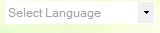
Number of Controls of the project
CODEHUB
Picture Box
Logo of the project
Combo Box
Language selection Combo box :-
Allow the user to interactively select the interested language from the collection of the languages.

Slide 13
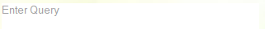

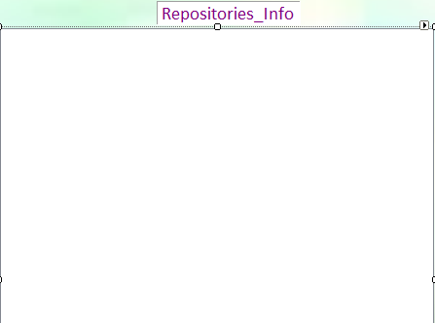
CODEHUB
Text Box:-Allow the user to interactively write the query in their natural language.
Radio buttons:-Select the source
List View:-Collect the Collection of the result repositories set contain the information, when select any repository then show the information of that repo in the message box

Slide 14
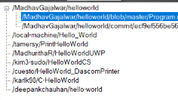
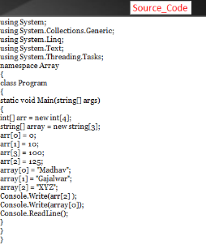
CODEHUB
Tree View:-contain all the main links to the repositories the visit
Parent Nodes
Child Nodes
Rich Text Box:-Contain Source Code file

Slide 15


Buttons:-Allow to do Action
Search Button-with Picture:-
ONCLICK
Check which of the source (radio button)selected then change the background image accordingly
First Check the Controls Filled or not if not Display Error Message box else, open the Progress bar then
Open the google chrome(Backend-Headless).
Scraping Button-with Picture—(Main)
ONCLICK
First Check the Selected radio button(source).
Then allow the agent(scraping-variable) of the google chrome to select the particular Tag of all the HTML document of the selected website
See code#2 in slide#13
CODEHUB

Slide 16
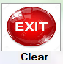



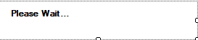
CODEHUB
Exit Button–with picture
Remove all the filled control to null and remove the
background picture
Next &Back Button-with picture
First check the mandatory fields filled or not then move next to Rank page
Progress Bar:-Give Interactive View

Slide 17
Packages
CODEHUB
using System.Drawing;
using System.Collections;
using System.Threading;
using Timer = System.Windows.Forms.Timer;
using Bunifu.UI.WinForms;
using Bunifu.Framework.UI;
using HtmlAgilityPack;
using IdentityModel.Client;
using Microsoft.AspNetCore.Mvc;
using OpenQA.Selenium;
Using OpenQA.Selenium.Chrome;
using System;
using System.Collections.Generic;
using System.Linq;
using System.Windows.Forms;
using System.Net;
using System.Text.RegularExpressions

Slide 18
Functions
CODEHUB
Open_Browser()
opengit()
opengeeks()
openprogramiz()
Find_Data();---Crawling
treeView(TreeNode e)
fadeOut(object sender, EventArgs e)

Slide 19
Function EventArgs
CODEHUB
btnopenbrowser_Click(object sender, EventArgs e)
btnexit_Click(object sender, EventArgs e)
listView1_MouseClick(object sender, MouseEventArgs e)
Form1_FormClosing(object sender, FormClosingEventArgs e)
timer1_Tick(object sender, EventArgs e)

Slide 20
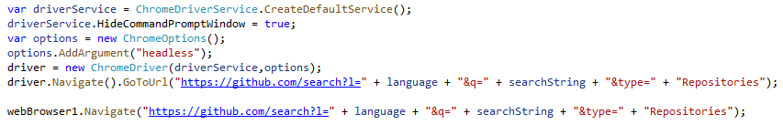
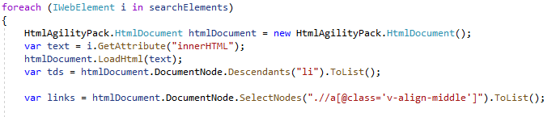
Code#1
Code#2

Slide 21
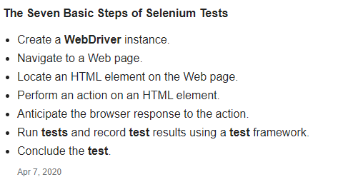
using OpenQA.Selenium; using OpenQA.Selenium.Chrome;
Selenium is a system for operating a web browser by remote control.
Selenium is a widely used open-source automation testing framework for web applications. Though Selenium supports number of programming languages like Java, C#, Ruby, Python to automate the tests, it also has capabilities to use with scripting languages like JavaScript.

Slide 22
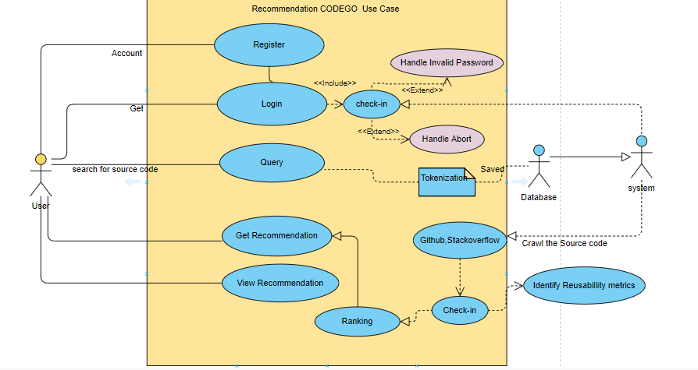
DFD’s Of the Project
CODEHUB

Slide 23
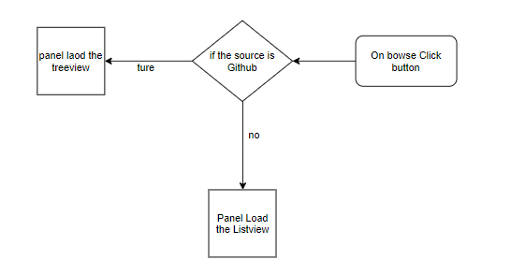
Panel Change
Because of the Nature of the Source Website we should choose the Control which is Done by using Control into Panel control to change accordingly

Slide 24
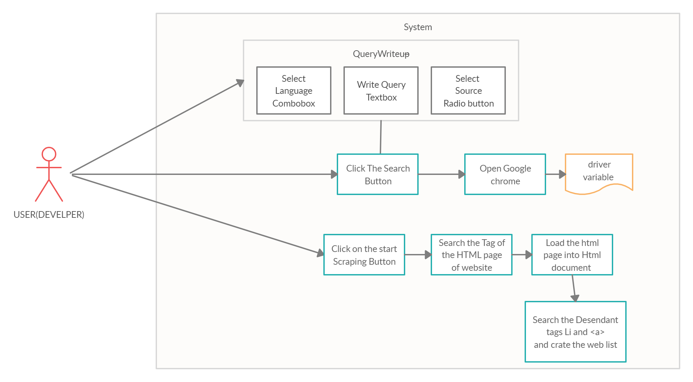
DFD’s Of the Project Modules
CODEHUB
Module:-
Frontend Interface

Slide 25
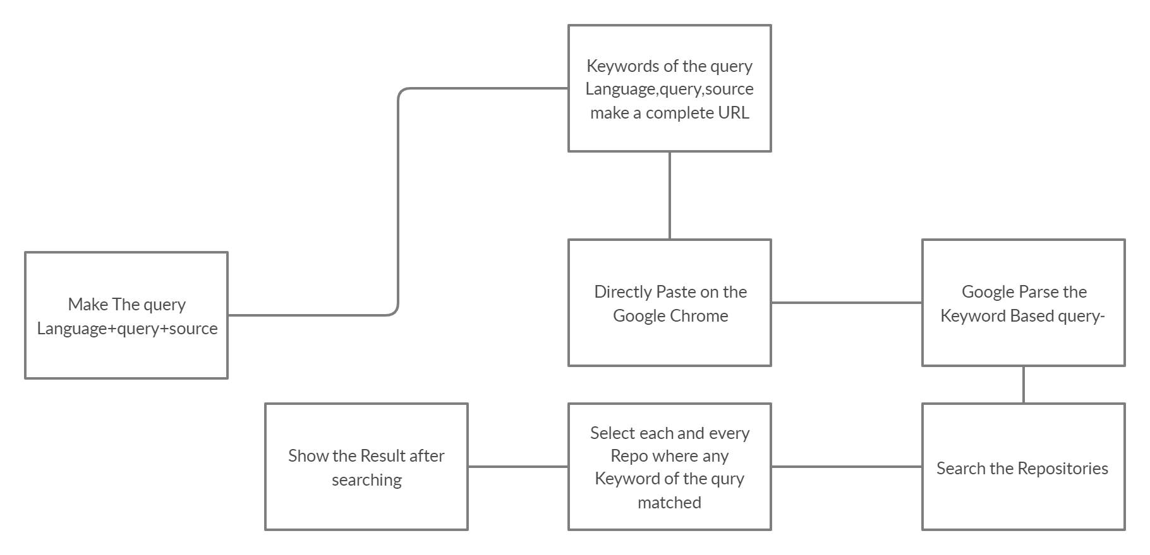
Query Module:-
Keyword-Based Searching:-
CODEHUB

Slide 26
Query Module:-
Semantic-Based Searching:-
Status
Pending……
CODEHUB

Slide 27
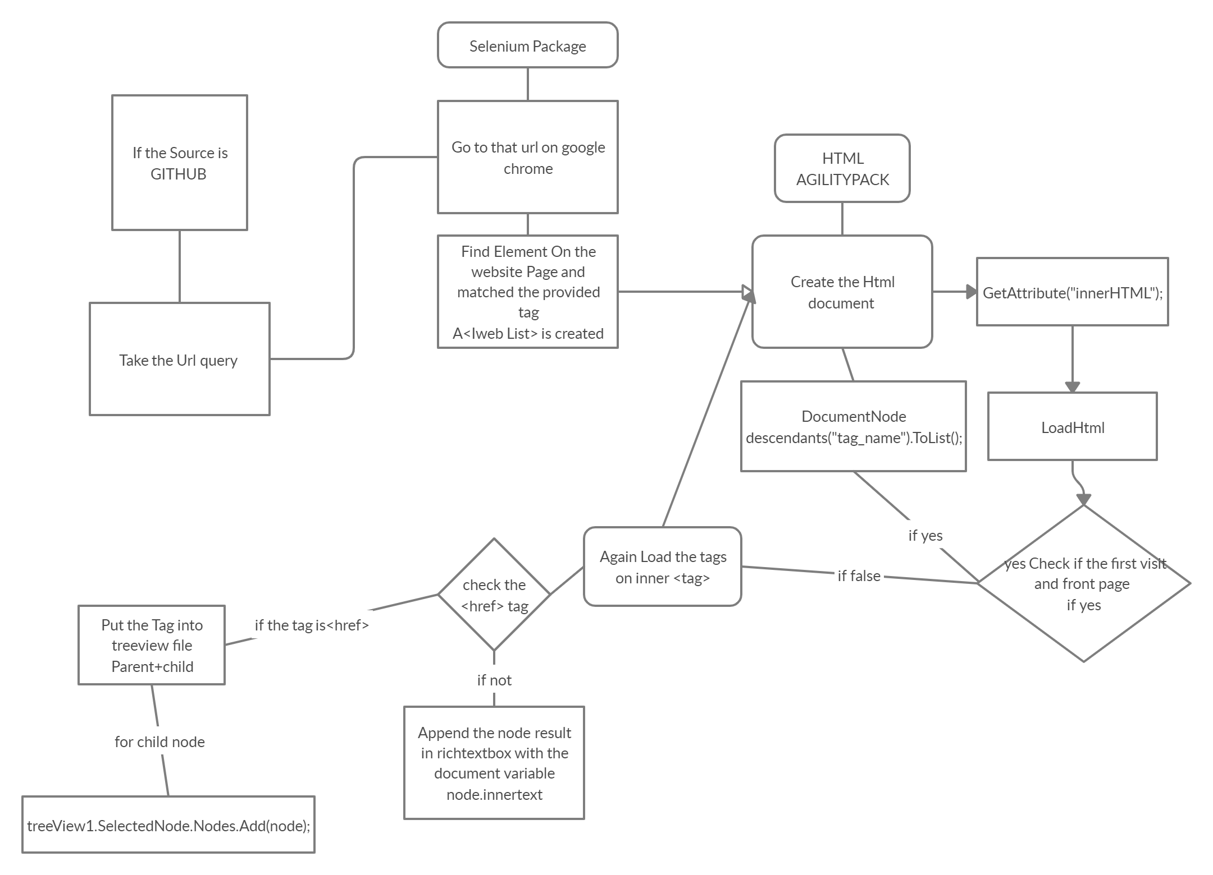
Crawling Module:-
CODEHUB

Slide 28
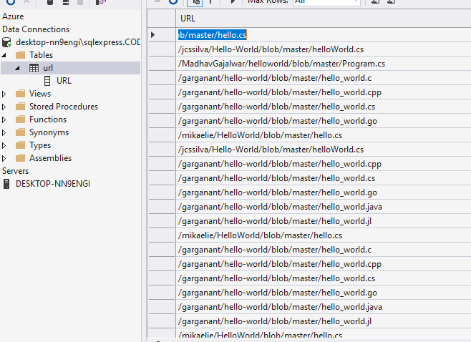
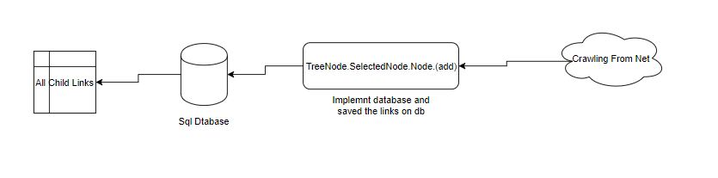
Database

Slide 29
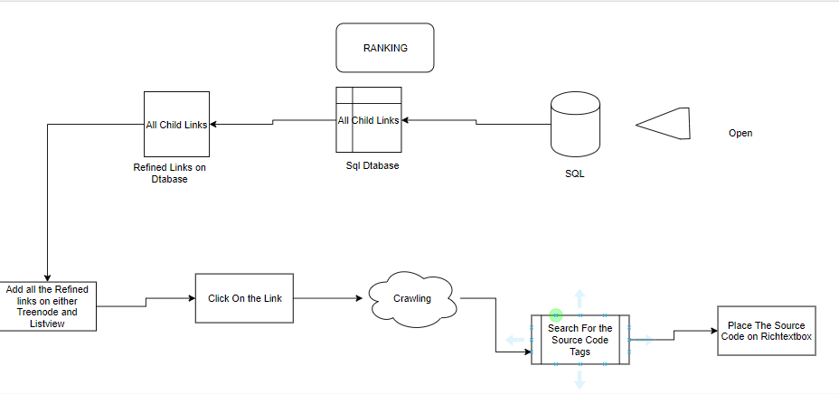
CODEHUB
Ranking Module:-
Deliverables:-
Filter Array(filter or refine the collection of links )
Algo:-
RefineArray(Parent link/child links/child links/…..)
If (child_link==“.cs”
If (matched)
Then treeView1.SelectedNode.Nodes.Add(child_link)
Else{
Again visit the next <href> tag and apply the check.
Check

Slide 30
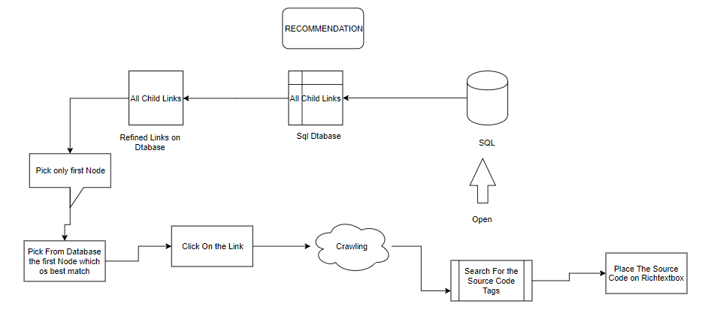
CODEHUB
Recommendation Module:-

Slide 31
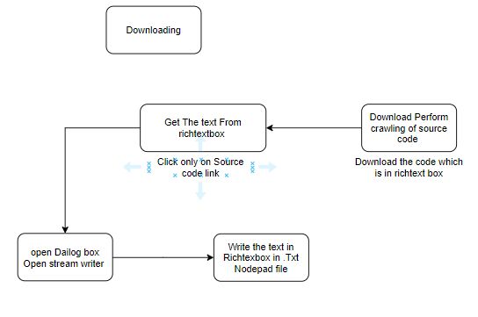
CODEHUB
Download Module:-

Slide 32
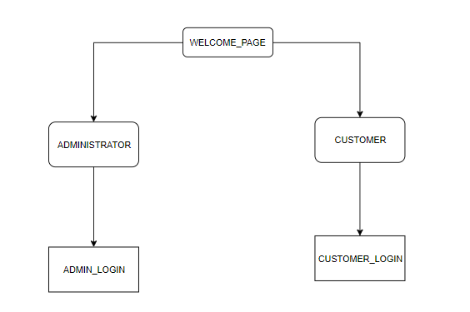

Slide 33

SPLASH SCREEN

Slide 34
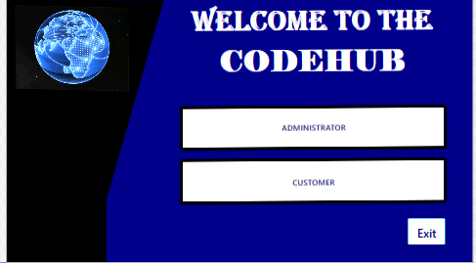
WELCOME WINDOW

Slide 35
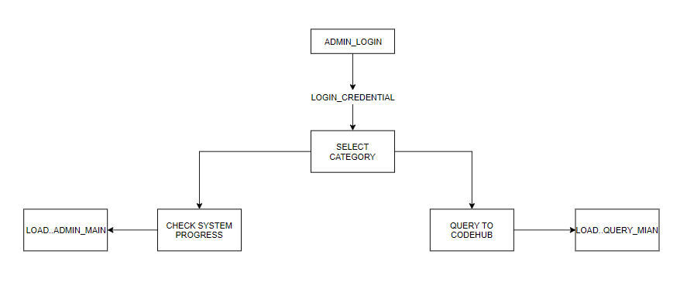

Slide 36
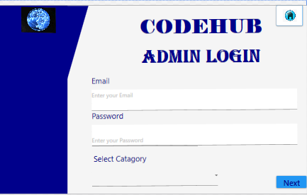

Slide 37
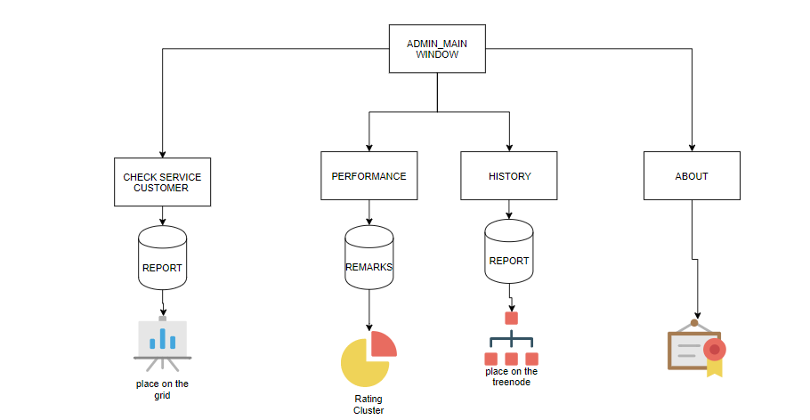

Slide 38
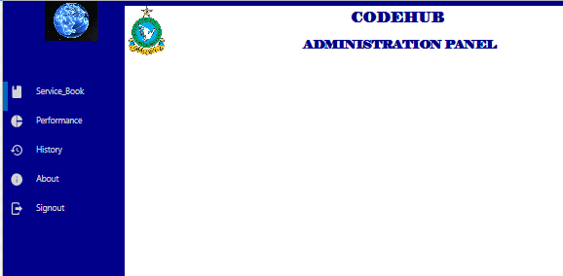

Slide 39
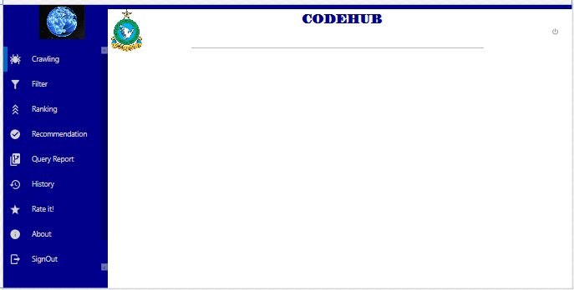

Slide 40
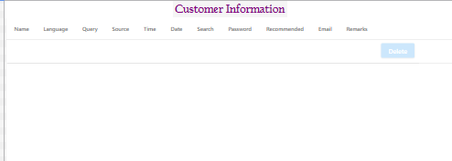

Slide 41
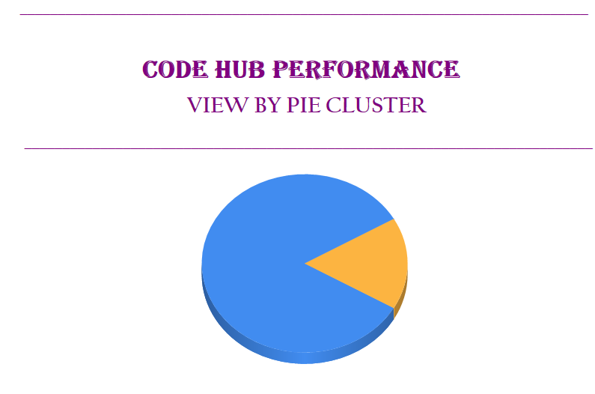

Slide 42
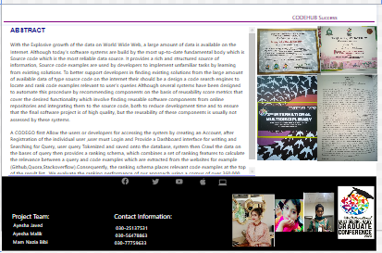

Slide 43
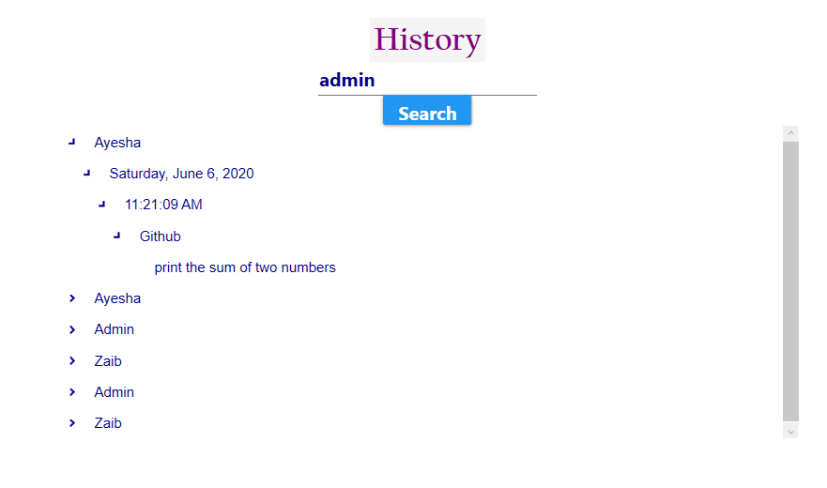

Slide 44
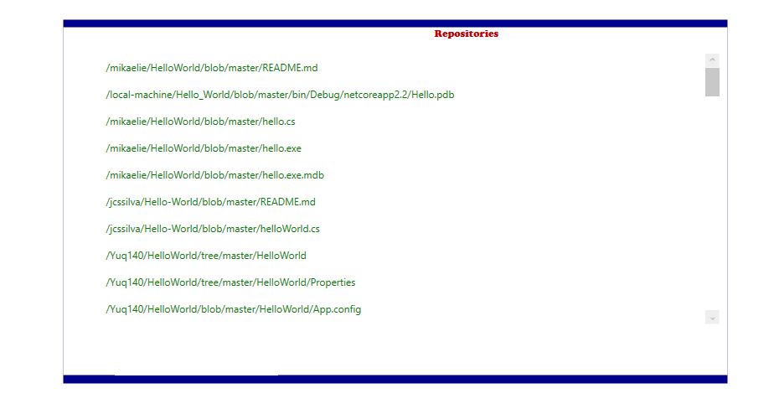

Slide 45
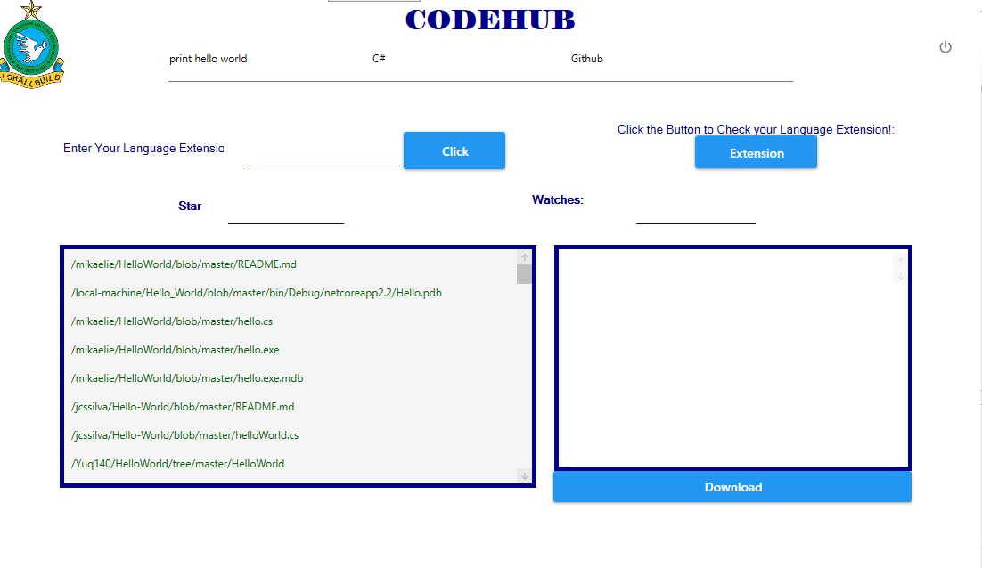

Slide 46
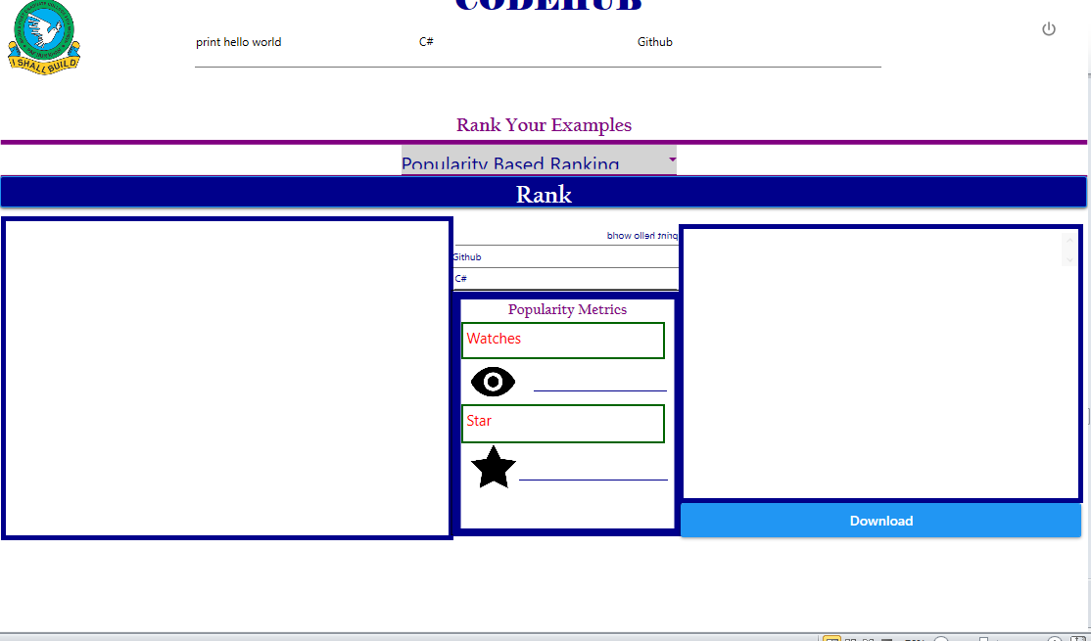

Slide 47
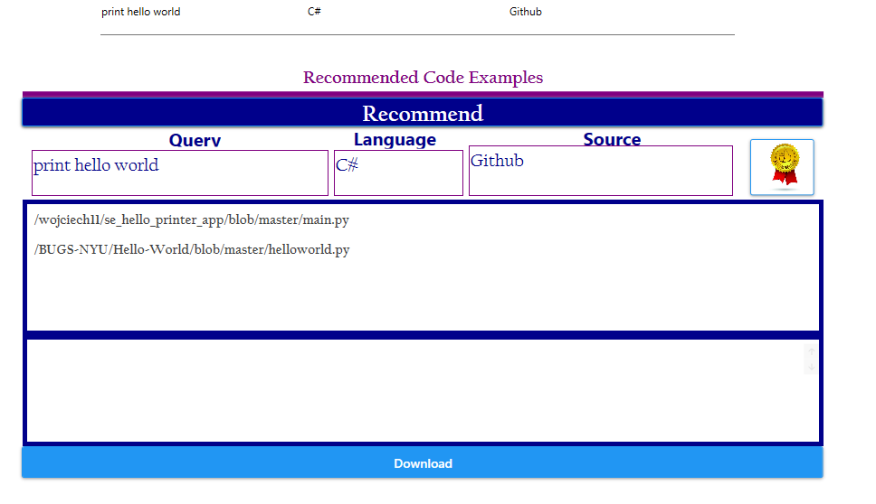

Slide 48
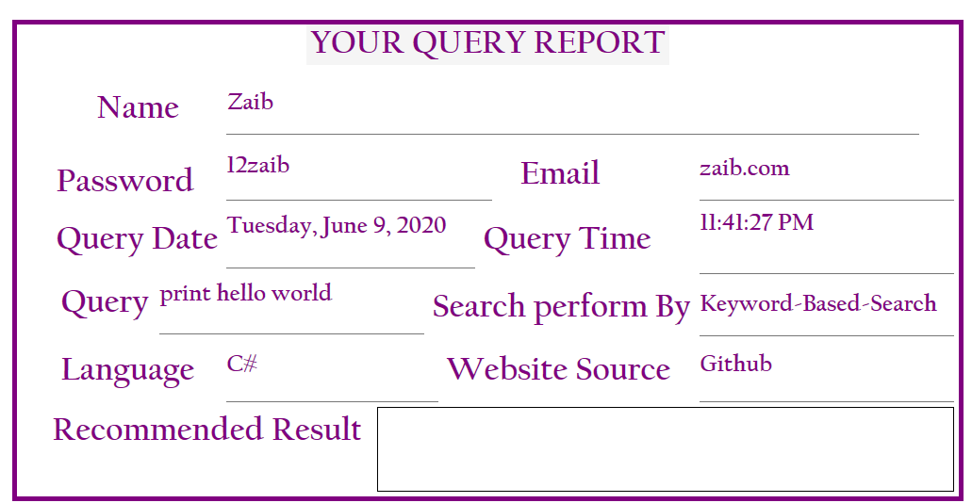

Slide 49
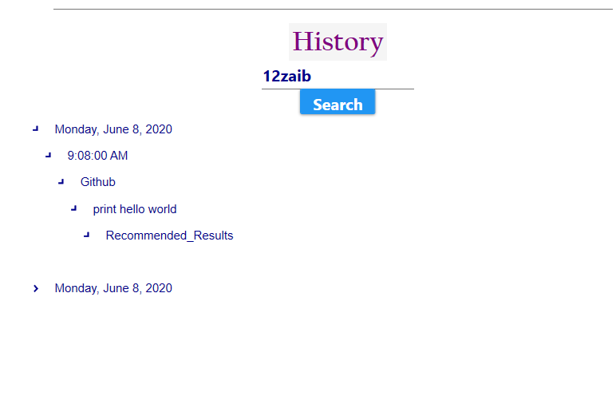

Slide 50
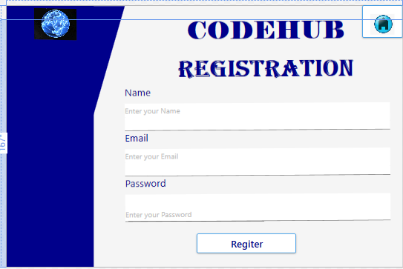

Slide 51
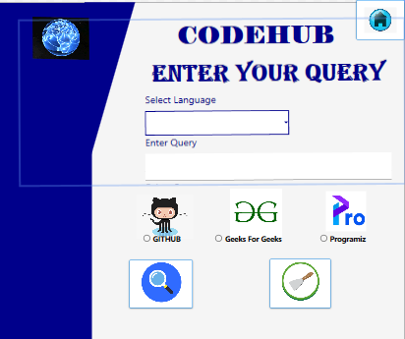

Slide 52
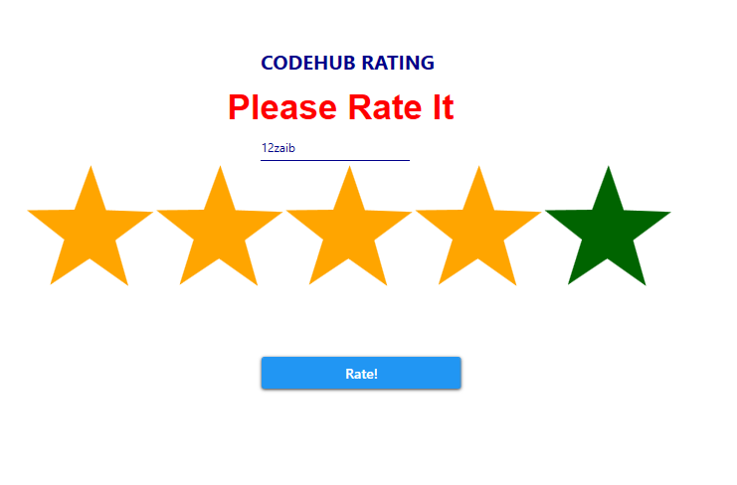

Slide 53
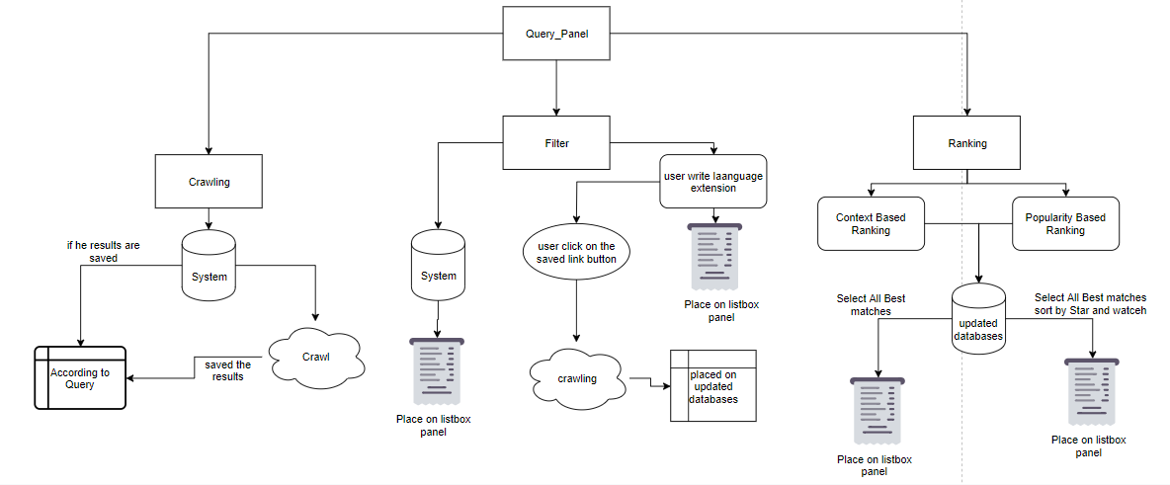

Slide 54
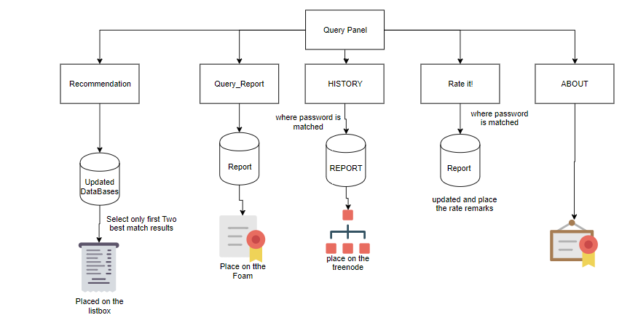

Slide 55
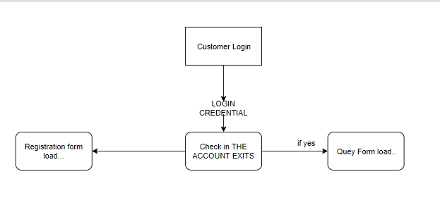

Slide 56


Slide 57


Slide 58






Software Used for this Project

Slide 59


Slide 60

CODEHUB

Slide 61

CODEHUB

Slide 62

CODEHUB

Slide 63

CODEHUB

Slide 64

CODEHUB

Slide 65


Slide 66


Slide 67


Slide 68


Slide 69


Slide 70


Slide 71


Slide 72


Slide 73


Slide 74


Slide 75


Slide 76
Project Reference GitHub, YouTube link for project demonstration
CODEHUB
https://github.com/ayesha786012/CODEHUB
https://www.youtube.com/watch?v=lkQfzX1m9n0

